Slide 1
How to use the TIMESTAMPADD parameter to retrieve by today - X time in an Alma Analytics report
Yoel Kortick | Sept. 2024

Slide 2
Introduction
Applying the TIMESTAMPADD filter on event date
Applying the TIMESTAMPADD filter on loan due date

Slide 3
Introduction

Slide 4
Introduction
There may be cases where the library is creating a report and does not want to "hard code" a date.
For example, the library may not want to know which items arrived from Sept. 06 – 12, but instead want to know which items arrived in the last week.
Similarly, the library may wish to know how many loans were made by users of group "Undergraduate" in the past year.

Slide 5
Introduction
By using a variable which controls the date the report is "dynamic" in that any time it is opened it automatically retrieves by the current date minus a certain number of days, weeks, months or years.
The variable is called TIMESTAMPADD
Thus, weekly reports may be called, for example, "Number of … in the last week"

Slide 6
Applying the TIMESTAMPADD filter on event date

Slide 7
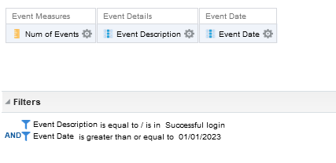
Applying the TIMESTAMPADD filter on event date
Here is the criteria tab of a report of successful logins after or on Jan. 1, 2023. It is created in the "System Events" subject area

Slide 8
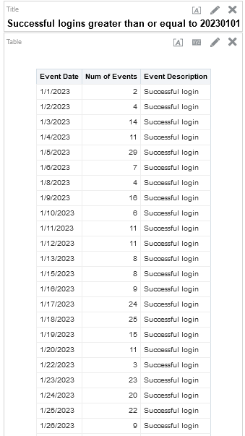
Applying the TIMESTAMPADD filter on event date
Here are the results

Slide 9
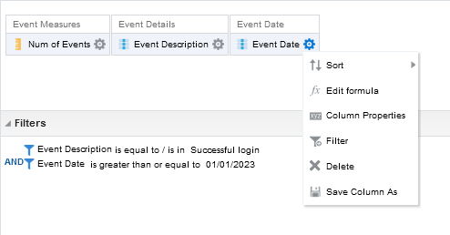
Applying the TIMESTAMPADD filter on event date
We will now make the report always bring the last three weeks.
Create any filter on the Event Date

Slide 10
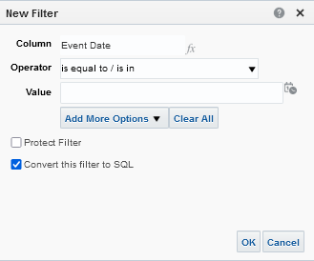
Applying the TIMESTAMPADD filter on event date
Select "Convert to SQL" and click OK

Slide 11
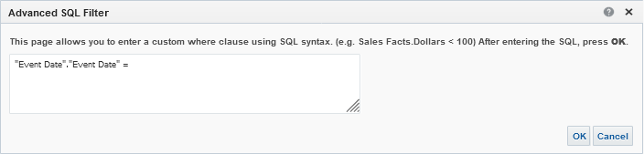
Applying the TIMESTAMPADD filter on event date
Now we see that we have:
"Event Date"."Event Date" =
We need to change this to reflect the kind of date retrieval we want

Slide 12
Applying the TIMESTAMPADD filter on event date
If we want all event dates in the last 14 days:
"Event Date"."Event Date" >= TIMESTAMPADD(SQL_TSI_DAY, -14, CURRENT_DATE)
If we want all event dates in the last 2 years:
"Event Date"."Event Date" >= TIMESTAMPADD(SQL_TSI_YEAR, -2, CURRENT_DATE)
If we want all event dates in the last 3 months:
"Event Date"."Event Date" >= TIMESTAMPADD(SQL_TSI_MONTH, -3, CURRENT_DATE)
If we want all event dates in the last 1 week:
"Event Date"."Event Date" >= TIMESTAMPADD(SQL_TSI_WEEK, -1, CURRENT_DATE)
If we want all event dates between today and 1 month from now:
"Event Date"."Event Date" BETWEEN (CURRENT_DATE) AND TIMESTAMPADD(SQL_TSI_MONTH, +1, CURRENT_DATE)
This syntax can be used for all date fields.
The user needs to only change the time units as needed.

Slide 13
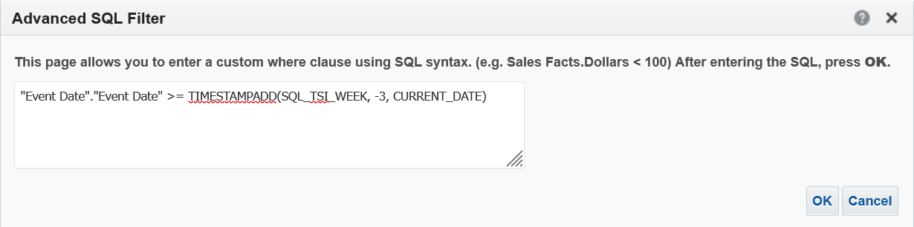
Applying the TIMESTAMPADD filter on event date
For example, here we will get all event dates in the past three weeks:
"Event Date"."Event Date" >= TIMESTAMPADD(SQL_TSI_WEEK, -3, CURRENT_DATE)

Slide 14
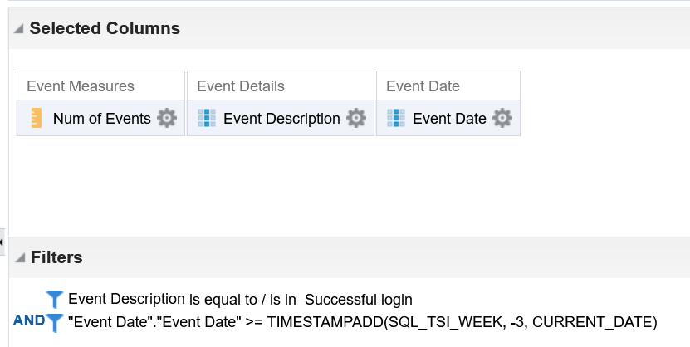
Applying the TIMESTAMPADD filter on event date
The filter has been added to the report

Slide 15
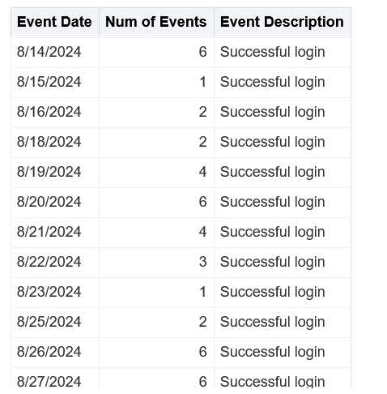
Applying the TIMESTAMPADD filter on event date
And now the report gives only the last three weeks (today is Sept. 04, 2024)
It goes as far back as three weeks ago

Slide 16
Applying the TIMESTAMPADD filter on loan due date

Slide 17
Applying the TIMESTAMPADD filter on loan due date
We will now create a report which retrieve all overdue items with a due date between three months ago and 1 day ago.
The TIMESTAMPADD retrieval for "less than one day ago" for the due date is:
"Due Date"."Due Date" <= TIMESTAMPADD(SQL_TSI_DAY, -1, CURRENT_DATE)
The TIMESTAMPADD retrieval for "greater than three months ago" for the due date is:
"Due Date"."Due Date" >= TIMESTAMPADD(SQL_TSI_MONTH, -3, CURRENT_DATE)

Slide 18
Applying the TIMESTAMPADD filter on loan due date
The TIMESTAMPADD retrieval for "between three months ago and one day ago" for the due date is:
"Due Date"."Due Date" BETWEEN TIMESTAMPADD(SQL_TSI_MONTH, -3, CURRENT_DATE) AND TIMESTAMPADD(SQL_TSI_DAY, -1, CURRENT_DATE)
When using BETWEEN:
The oldest date (in this case three months ago) should appear before the more recent date (in this case one day ago)

Slide 19
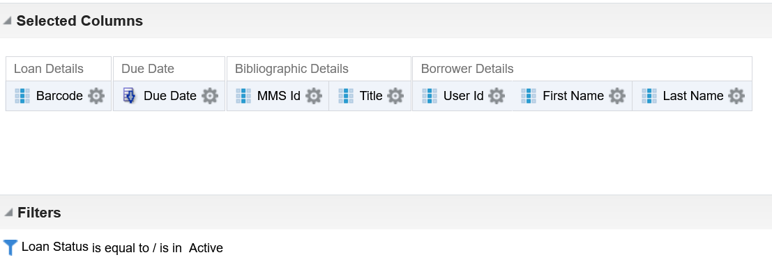
Applying the TIMESTAMPADD filter on loan due date
Here we have a report of all active loans and the due date

Slide 20
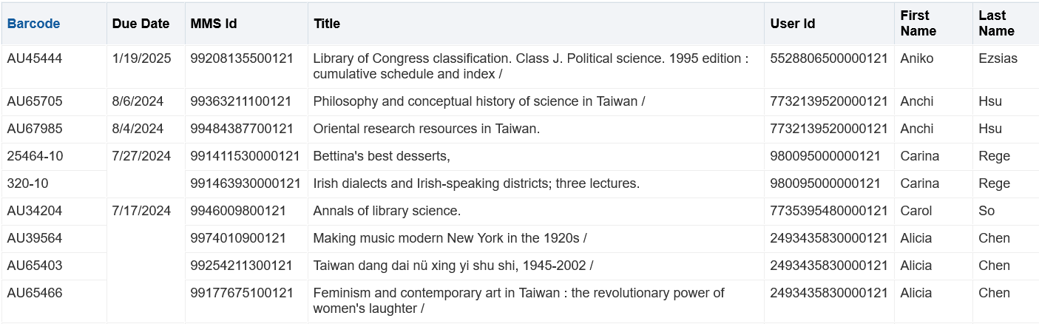
Applying the TIMESTAMPADD filter on loan due date
The output has all loans regardless of due date because currently there is not a filter on the due date

Slide 21
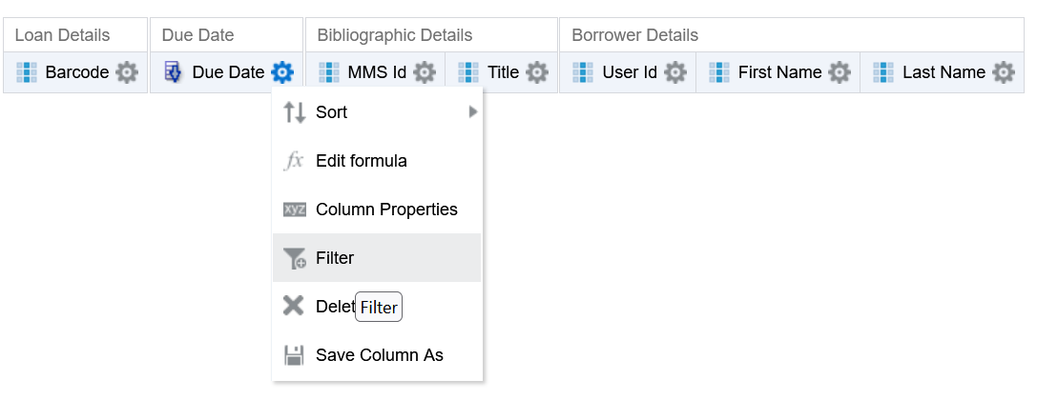
Applying the TIMESTAMPADD filter on loan due date
In order to use the TIMESTAMPADD add we will do "Filter > Convert to SQL" on the "Due Date"."Due Date"

Slide 22
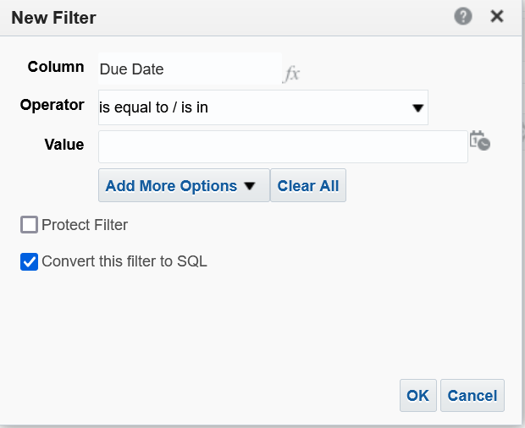
Applying the TIMESTAMPADD filter on loan due date
In order to use the TIMESTAMPADD add we will do "Filter > Convert to SQL" on the "Due Date"."Due Date"

Slide 23
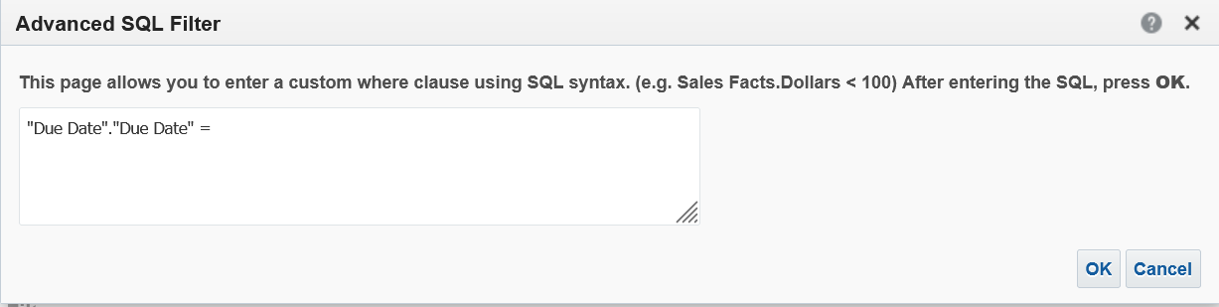
Applying the TIMESTAMPADD filter on loan due date
We have the following, and will change it to
"Due Date"."Due Date" BETWEEN TIMESTAMPADD(SQL_TSI_MONTH, -3, CURRENT_DATE) AND TIMESTAMPADD(SQL_TSI_DAY, -1, CURRENT_DATE)

Slide 24
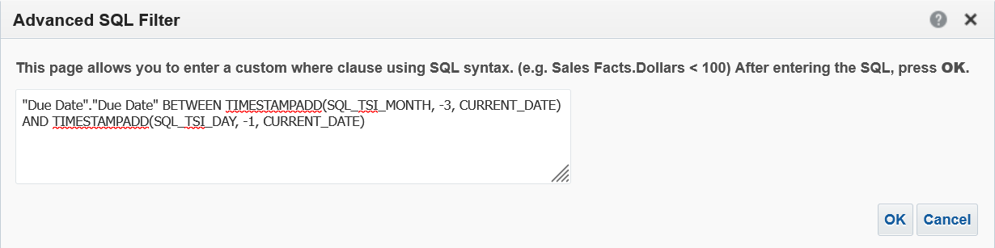
Applying the TIMESTAMPADD filter on loan due date
Here is the new filter

Slide 25
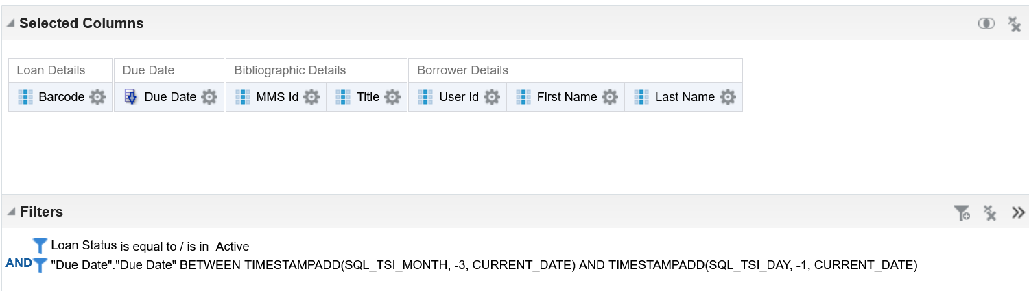
Applying the TIMESTAMPADD filter on loan due date
Here is the new filter

Slide 26
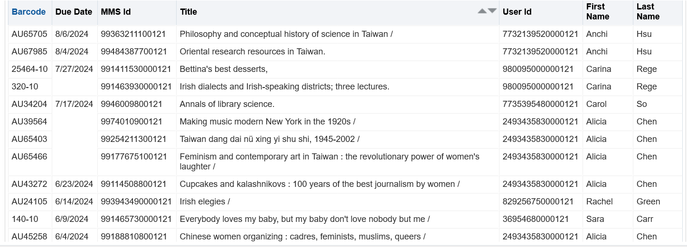
Applying the TIMESTAMPADD filter on loan due date
Now we have due dates between three months ago and one day ago (if such dues dates exist).

Slide 27
Thank You.
Yoel Kortick

